Slide 1
Stocko Sprint 3
Brendan Lucich, Alex Davis, Andrew Setka, Brady Mack
Source Code: https://github.com/Asetka/Stocko/tree/dev
Project Website: https://stocko.xyz
Jira: https://housing.atlassian.net/jira/software/projects/STOCKO/boards/2/backlog
ReadMe: https://github.com/Asetka/Stocko/tree/dev/sprint_deliverables

Slide 2
Stocko
Web app designed to provide casual investors with more information for long-term personal investments
Focused on an analytical process to investment in stocks
Use financial data about a company to provide evaluation metrics to determine the intrinsic value of the company

Slide 3
Backlog of Sprint 2 Goals
Story | Assignee(s) | Points
Create new Chart and identify the data needed for it | Andrew | 6
Change any UI that looks weird and fix some calculations | Davis | 8
Fix and optimize the positions API | Brady | 8
Create the education page | Brendan | 21
Document the API | Andrew | 8
Notes:
Jira
https://housing.atlassian.net/jira/software/projects/STOCKO/boards/2/backlog
https://docs.google.com/document/d/11fXwnk1gAuYx-7HyRQba3VkH9B8AzGvIzvyoV3V2uHA/edit

Slide 4
Sprint 2 vs Sprint 3
In Sprint 3 we focused on doing the following better
Identifying bugs and coming up with solutions to them as a team
Learning more about how the others were implementing their piece
Asking each other for opinions on ways we implement pieces
Making the UI flow slightly better
Make the app easier for a user to understand

Slide 5
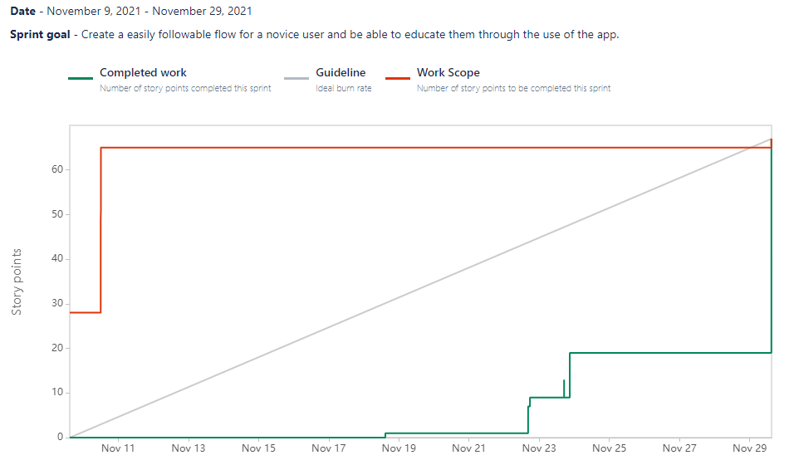
Burnup Chart (as of Sprint 3 Completion)

Slide 6
Sprint 3 Retrospective
Did a great job of working together on identifying and solving bugs
The user interface looks polished
Error checking was added in and works well
Semi-struggled with workarounds for the now missing AlphaVantage API data, how to keep the educational component interesting, and adding in authorization to the API requests
We could still coordinate and work together more often.
There were challenges with the API routing that was messing with results, the AlphaVantage changed their schema, Our Evals had a weird value checking bug

Slide 7
Andrew’s Contribution
Changed the Chart to be more informative
Now an OHLC candlestick chart
Also added in a Volume bar chart to help show popularity of the stock
Added required authentication to API
Only on API calls that access our DB
API documentation
Contributed to education page content
Deliverables
Sprint Goals
Sprint Retro
Sprint slides

Slide 8
Alex’s Contribution
Added Balance Sheet, Income Statement, and Cash Flow to Stock Page
Reformatted UI Elements.
Formatted the education page on the wiki side of the app.
Fixed Front end bugs.

Slide 9
Brady’s Contribution
Error Checking
Eliminated possibility for duplicate positions
Removed possibility for adding a ticker not supported by API
Beautified API Results
Fixed decimals on positions page
Positions bug fixes
Fixed math for % gain and profit
Contributed to education page content
Deliverables
Test cases
Recorded video

Slide 10
Brendan’s Contribution
Created the education page and documentation
Data schema changes to fix the resulting issues, errors, and bugs from the AlphaVantage API data packet change
Bug fixes and optimization throughout the application

Slide 11
Demo
Show the app working
Demonstrate the standard user flow
Explain what the calculations mean

